Slide 1
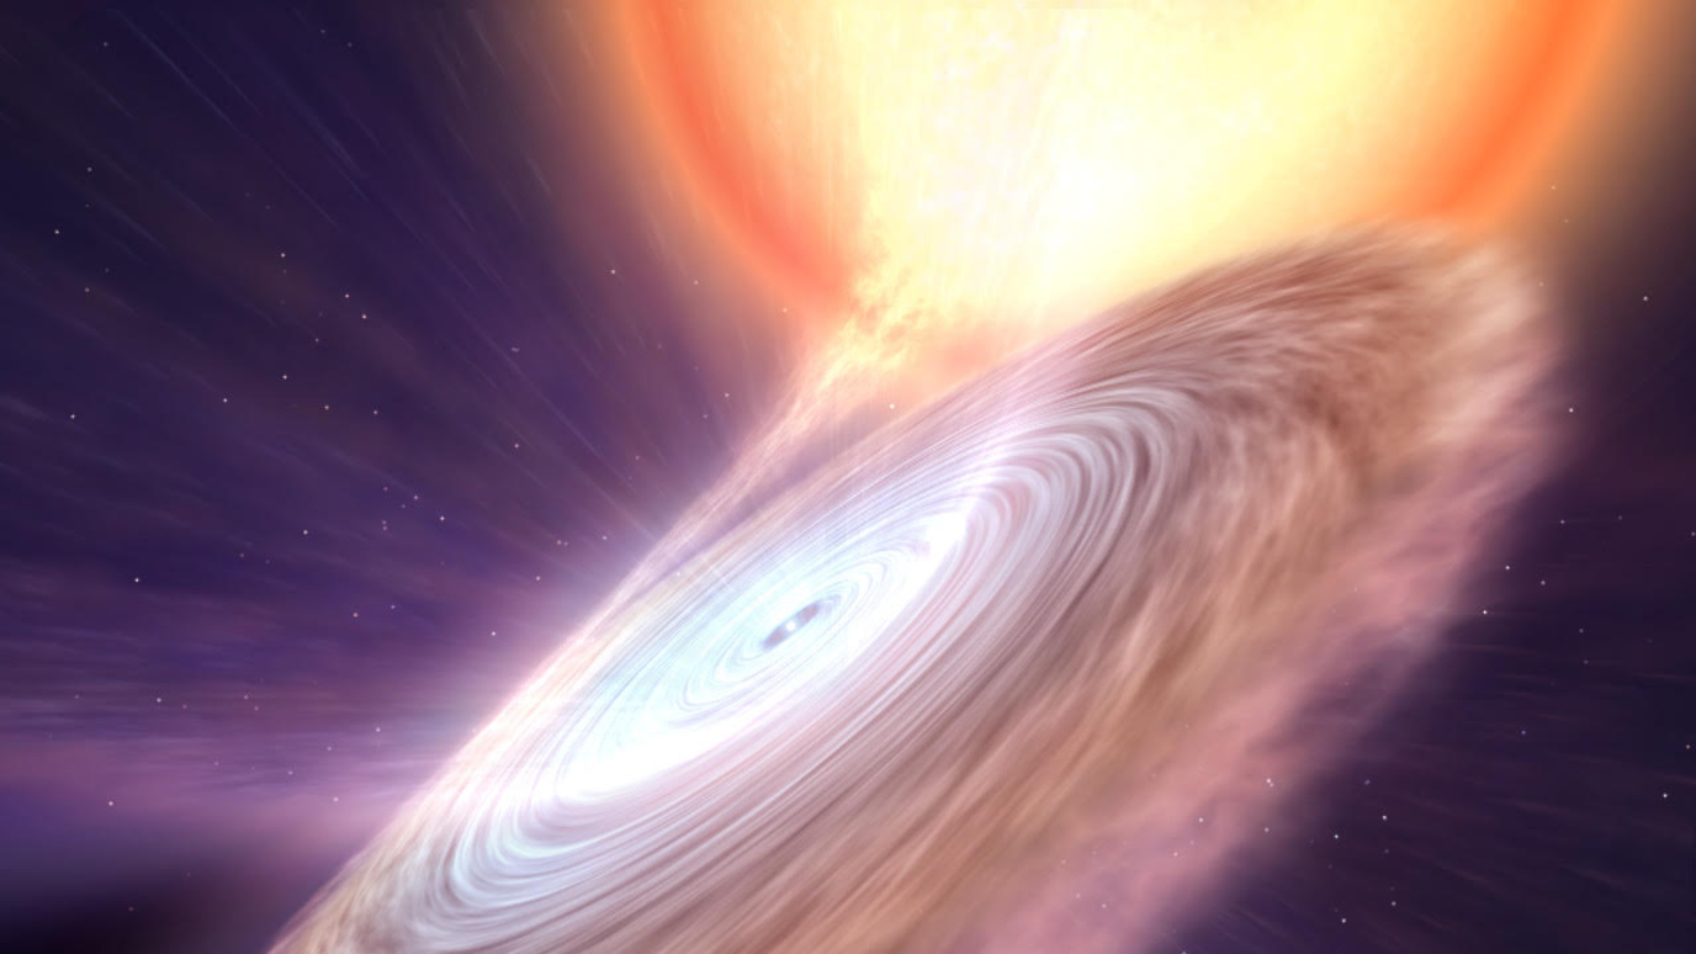


X-ray Binaries as Flashlights to Map the Universe Through Stellar Wind Studies
ARIZONA
Calvin Sam, Tristen Sextro
Mentor: Dr. Pragati Pradhan
Department of Physics and Astronomy | College of Arts & Sciences
SPACE GRANT
CONSORTIUM
@ Gabriel Pérez Díaz, SMM (IAC)
Notes:
Say thanks to heasarc support team, embry riddle, space grant, uri, here

Slide 2
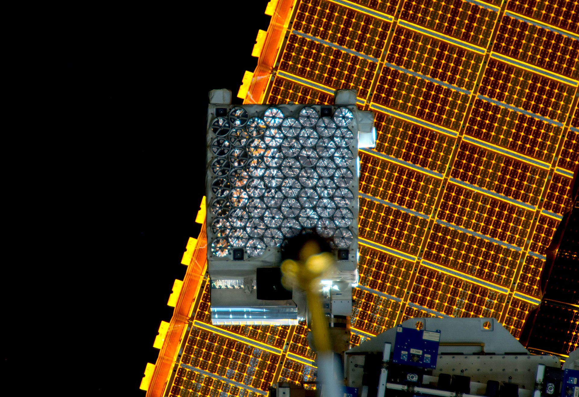
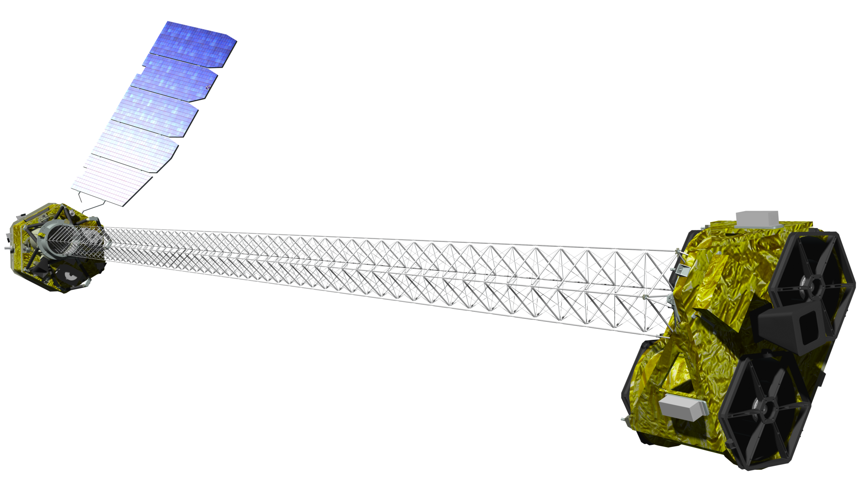
Motivation
GX 1+4
  Measure absorption and the iron line variation to find estimate density/composition of clumps
  Correlates to evolution of galaxies
4U 1822-37
  Very large magnetic field ~10^12 gauss
  Model how matter behave in such strong magnetic fields
@ NASA/JPL-Caltech
Notes:
GX 1+4
X-rays from object is intercepted by in-homogeneties in stellar wind
Measure absorption and the iron line variation to find estimate density/composition of clumps
Studies have wider astrophysical relevance since clumps effect stellar evolution which in turn effect evolution of galaxies
4U 1822-37
Very large magnetic field ~10^12 gauss
Model how matter behave in such strong magnetic fields (millions K temp)

Slide 3
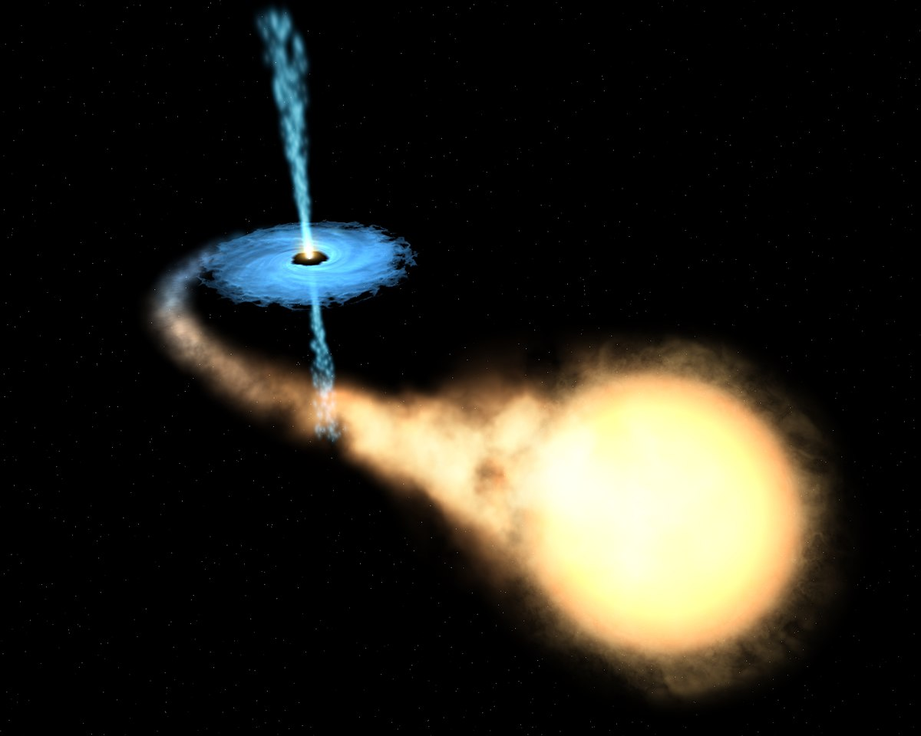
What are low mass X-ray binaries?
Low mass X-ray binaries (LMXBs) consist of a low mass star and a compact object (such as a black hole or neutron star)
@ ESA/Hubble

Slide 4
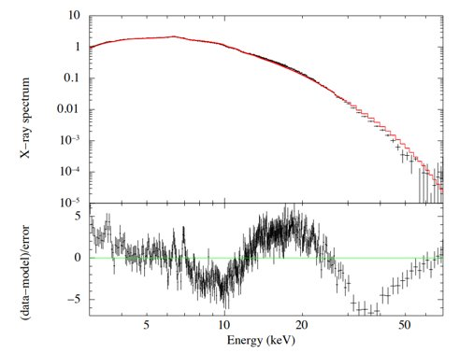
4U 1822-37 Findings
Notes:
Using HEASoft to reduce the data and XSPEC to plot and fit the data.
Absorption lines of silicon/iron present
Cyclotron resonance potentially present at the high energies

Slide 5
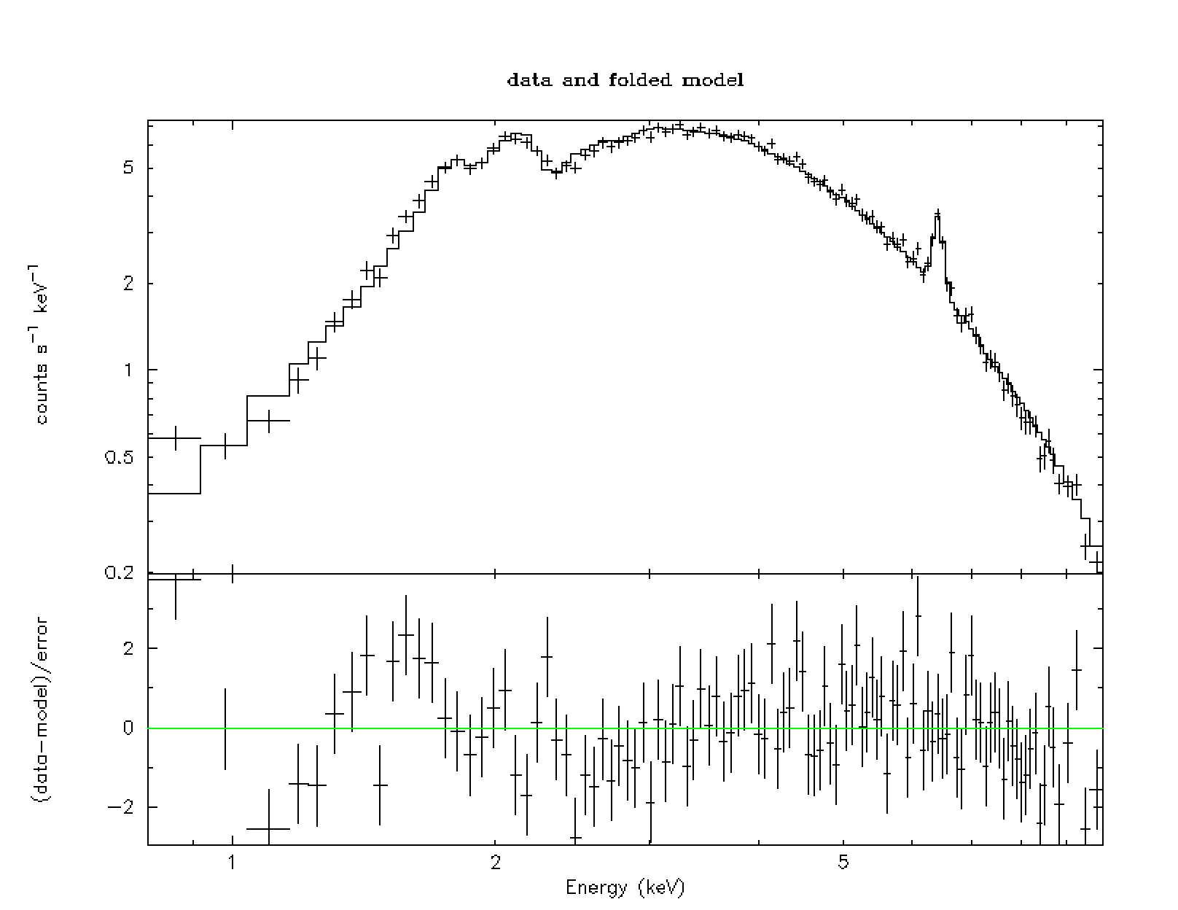
Gx 1+4 Findings
Notes:
HEASoft utilized to reduce and present X-ray spectrum
One of ~30 observations
Prominent iron line at 6.4 keV

Slide 6
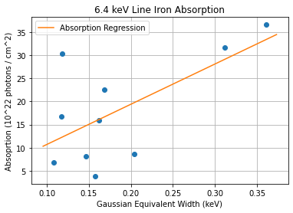
6.4 keV Line Analysis
Notes:
Iron Line Width as a function of X-ray absorption
As expected, a linear trend
Outlier Potential Causes
Centrifugal/Magnetic Gating
Ionized Clumps

Slide 7
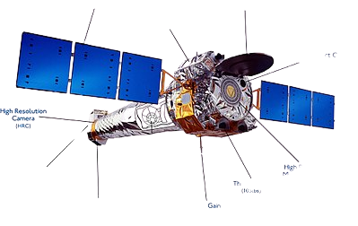
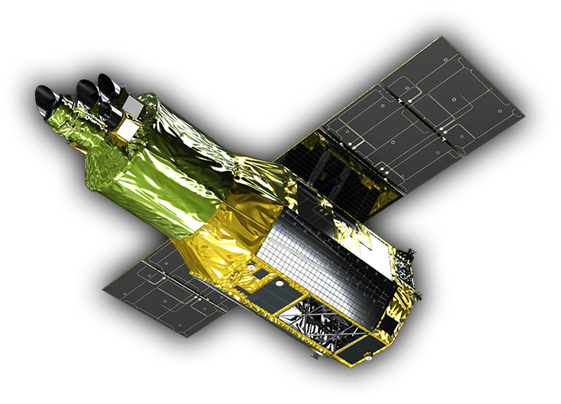
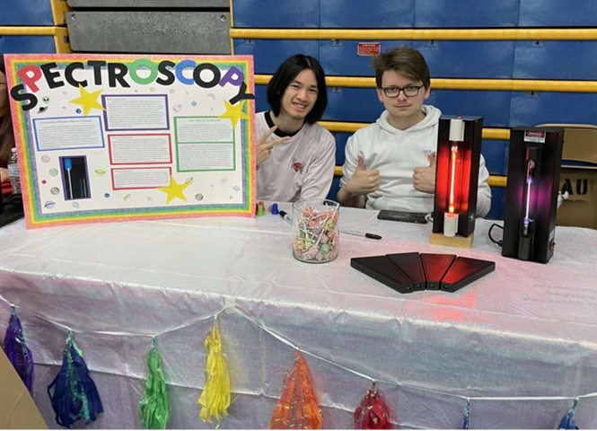

Future Plans
GX 1+4
  Check variability of 6.4 keV Iron Line over remaining observations
  Observation with Chandra and XRISM
4U 1822-37
  Model the spectrum using alternative models like the reflection model for Accretion Dominated Corona (ADC)
@ NASA/JAXA
Notes:
GX 1+4
Check variability of 6.4 keV Iron Line over remaining observations
MAXI/GSM - Variability over many years
Ongoing observation with Chandra for high spectral resolution to resolve other prominent iron lines
Future observation with XRISM for significantly higher spectral resolution and larger detector area
4U 1822-37
Model the spectrum using alternative models like the reflection model for Accretion Dominated Corona (ADC)

